Slide 1
Domain Models/Class Diagram

Slide 2
Domain Models/Class Diagram
Object oriented models (diagrams) to define classes of objects and their states
Domain Models
Class Diagram
A class diagram in the unified modelling language(UML) is a type of static structure diagram that describes the structure of a system by the system’s classes their attributes, operations/methods and the relationship among objects.

Slide 3
The main purpose of class diagram is to model/Analysis/design of the static view of an application
Class diagrams are the only diagrams which can be directly mapped with object oriented languages and thus widely used at the time of software construction.
Class diagram is basically a graphical representation of the static view of the system and represents different aspects of the application.
A collection of class diagram represents the whole system.

Slide 4
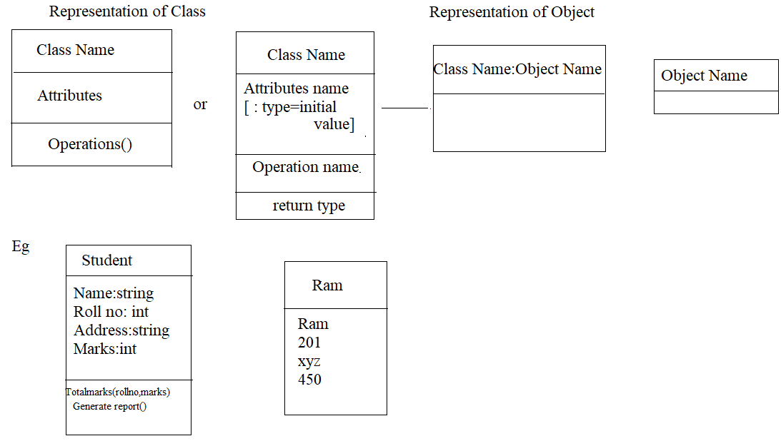

Slide 5
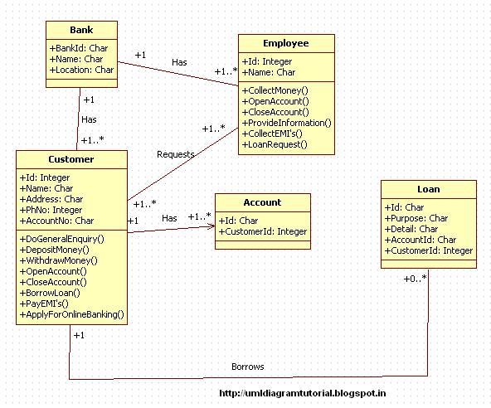
Class diagram for bank system

Slide 6
Thank you

